Slide 1
CMOS
Oleg Ladin
21 September 2020

Slide 2
Course materials
Lectures: https://mipt-ilab.github.io/mipt-mips/
GitHub: https://github.com/MIPT-ILab/mipt-mips/
Form for participants (link) – please fill it

Slide 3
Layers of Abstraction in CS
Application
Algorithms
Programming Language
Operating System
Instruction Set Architecture
Microarchitecture
More about voltages, wires and transistors…
Gates/Register-Transfer Level (RTL)
Circuits
Topics of
this lecture
Less about electrons, semiconductors…
Physics

Slide 4
Reminder: MOSFET
The metal-oxide-semiconductor field-effect transistor (MOSFET, «МОП-транзистор») acts as a voltage-controlled switch with three terminals: source, drain, and gate
There are two variations of the MOSFET: the n-channel (this slide) and the p-channel
Source
Gate
Drain
Metal
Oxide layer
N-type semiconductor
-
-
-
P-type semiconductor
-
-
-
+
+
+
+

Slide 5
Reminder: N and P-type MOSFET
N-type MOSFET:
Drain
Gate | State | Input (Source) | Output (Drain)
1 | On (conduct) | 0 | 0
 |  | 1 | weak 1
0 (any other value than 1) | Off (not conduct) | any | Z
Gate
Source
P-type MOSFET (similar to N-type, but all is inverted):
Source
Gate | State | Input (Source) | Output (Drain)
0 | On (conduct) | 0 | weak 0
 |  | 1 | 1
1 (any other value than 0) | Off (not conduct) | any | Z
Gate
Drain

Slide 6
Reminder: Invertor
!A
Input
Output
Input | Output
0 | Z
1 | 0
Input | Output
0 | 1
1 | Z
Input | Output
0 | 1
1 | 0
Vcc
Vcc
1
Source
1
Gate
Input
Z
Output
Drain
Drain
1
0
Gate
0
Source
0
The bottom part
The top part
The full scheme

Slide 7
CMOS

Slide 8
CMOS Circuits
Complementary metal–oxide–semiconductor (CMOS, «КМОП») is a technology for constructing integrated circuits
The main characteristics of CMOS devices is low static power consumption
There is no current in static state of the scheme (i.e. the power supply is never connected to the ground)
CMOS schemes always contain two complementary parts
One part consists of P-type transistors and is connected to the power supply and provides 1 to the output
The other consists of N-type transistors and is connected to the ground and provides 0 to output
When one part is turned on the other part is disabled (provides Z)

Slide 9
CMOS NAND Circuit
Vcc
Vcc
1
1
A | B | Output
0 | 0 | 1
0 | 1 | 1
1 | 0 | 1
1 | 1 | 0
!(A&B)
A
A
B
A
B
Output
B
Output
Output
Output
A
A
B
B
0
0
The bottom part
The top part
The full scheme

Slide 10
Time and Power

Slide 11
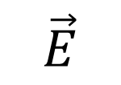

Transistor equivalent scheme
$$\vec{E}$$
$$\vec{j}$$
MOSFET has some parasitic capacities...
and resistivity

Slide 12
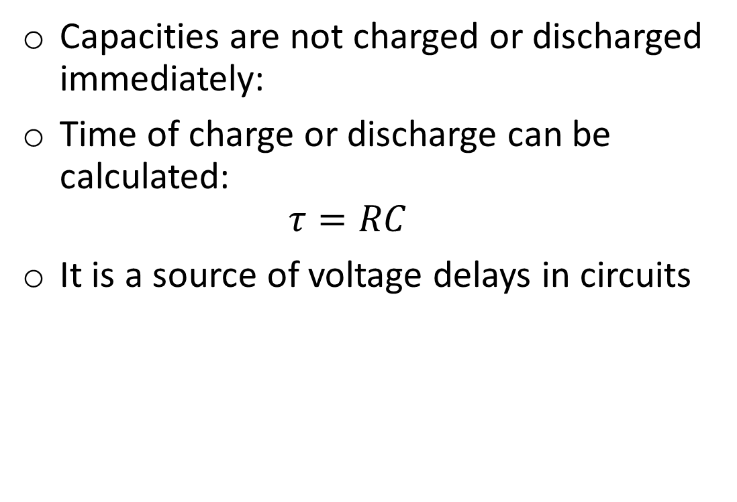
Timing
Vcc
Capacities are not charged or discharged immediately:
Time of charge or discharge can be calculated: $τ=RC$
It is a source of voltage delays in circuits
+ −
0
1
1
Output
1
1
0

Slide 13
Power Consumption in CMOS
Vcc
1
No current in static state, i.e. there is no power consumption
Current exists only at switch from one state to another to recharge the capacities
Input
Output
Input
1
0
+
+
0
Source
Gate
Drain
Drain
Gate
Source
1
-
-
n
n
p
p
p
n
No connection between the power supply and the ground
Output
Gate

Slide 14




Recharging Power
$$E_{R}=\frac{CV^{2}}{2}$$
$$E_{C}=\frac{CV^{2}}{2}$$
$$E_{R}=\frac{CV^{2}}{2}$$
$$P=CV^{2}f$$

Slide 15
Production

Slide 16
YouTube videos
“How a CPU is made“ explains how integrated circuits (IC) are created
“Intel: The Making of a Chip with 22nm/3D Transistors“ shows the whole process shortly
Steps description: From sand to silicon: the making of a chip

Slide 17
Thank You

